Slide 1

Orbital Ordering in Heavy-Hex LUCJ Sampling for SQD
Research Presentation - RIKEN R-CCS
Max Solovev
03/09/2026

Slide 2
Introduction
Discussing issues with the LUCJ ansatz and a proposed solution

Slide 3
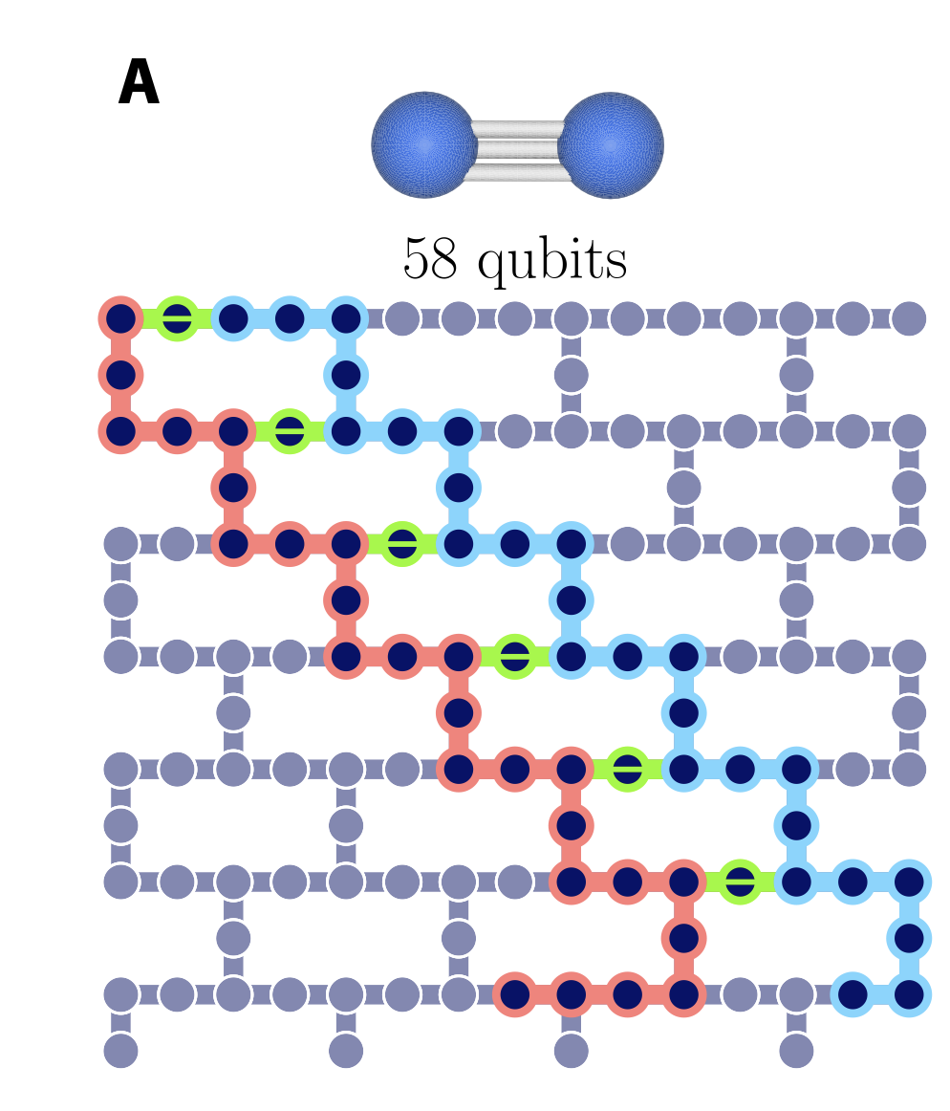
Current issues with the LUCJ ansatz
A brief overview of the problem
IBM processors have a fixed heavy-hex qubit connectivity
The LUCJ ansatz adapts to this topology in two ways:
Nearest neighbour same-spin Jastrow couplings
Sparse opposite-spin couplings at fixed anchor positions
The heavy-hex truncation removes a lot of potentially useful orbital couplings
The orbital-to-qubit assignment determines:
Which same-spin orbital pairs remain coupled
Which orbitals receive the few opposite-spin anchor couplings
e.g - When N_{orb} = 36, only 5.6% of possible same-spin pairs are retained by the heavy-hex mask.
This changes which determinants are sampled and can reduce the accuracy of the SQD energy.

Slide 4
SQD needs a different optimisation target
The LUCJ ansatz plays a different role in VQE vs SQD
In VQE, the ansatz state is the final variational approximation: min⟨ψ_{LUCJ​}∣H∣ψ_{LUCJ​}⟩
In SQD, the LUCJ ansatz is merely sampled – not the solution!
A layout with worse variational energy can produce a better finite subspace
Low LUCJ variational energy is not a sufficient objective for SQD
LUCJ Ansatz
1
Bitstrings
2
Selected Subspace
3
SBD/SQD Energy
4

Slide 5
The proposed solution
How can we optimise the subspace for SQD calculations?
The heavy-hex graph is fixed by hardware – the orbital-to-qubit assignment is not
Lever 1 – Anchor selection: Which orbitals occupy the sparse opposite-spin sites?
Lever 2 - Choose the same-spin orbital order along the heavy-hex chains, which determines the nearest-neighbours.
Selection metric - Prioritise anchor assignments with high retained opposite-spin Jastrow weight
Novelty:
The zig-zag layout has been unchanged since Motta et al., Chem. Sci. 2023, every SQD application since then inherits it – no published work varies it or reports its effect
Nearest work (Sung et al. 2025) re-optimises parameters under a fixed mask; we choose what the mask keeps
Goal:
Better masked LUCJ state
Better sampled SQD subspace
More accurate recovered energy

Slide 6
Experimental pipeline and validation
What does the structure of the experiment look like?
1
PySCF
2
LUCJ Circuit
3
SBD diagonalisation
4
Aer (Qiskit) Sampling
Validate by calculating SQD ground-state electronic energy of N₂
Using Shirakawa-san’s SBD repository (data/n2 > 1em4-alpha.txt)
In the pipeline, sbd code used unmodified, Stages 1-3 all unique from benchmark.
Published Result | My Result
-109.04835269 Ha | -109.04835269469… Ha

Slide 7
Does layout matter?
Quantifying the effect of orbital-to-qubit assignment on SQD accuracy

Slide 8
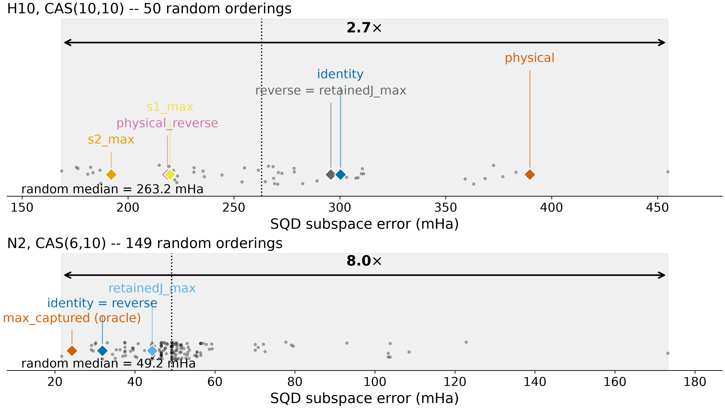
Orbital layout changes the answer by 8x
Same Hamiltonian, same shots, same 225-determinant budget
N₂ CAS(6,10): 149 random layouts - 21.65 → 173.23 mHa error
H₁₀ CAS(10,10): 50 random layouts – 168.67 → 454.89 mHa error
Only the orbital-to-qubit map changed
Seed-to-seed deviation: Zero
Between/within variance ratio
27.2 (N₂) and 278.2 (H₁₀)
Orbital ordering matters here!

Slide 9
Two surprises in the baseline
Geometric ordering fails, and the inherited convention is inconsistent
Geometric ordering (orbitals by position along the chain) – 2nd percentile
Spatial locality is actively harmful here
Inherited layout – 4.7th percentile on N₂ but 26th on H₁₀
Canonical orbitals arrive in a lucky order – localised orbitals don’t

Slide 10
Why does it matter?
The mechanism behind orbital ordering

Slide 11
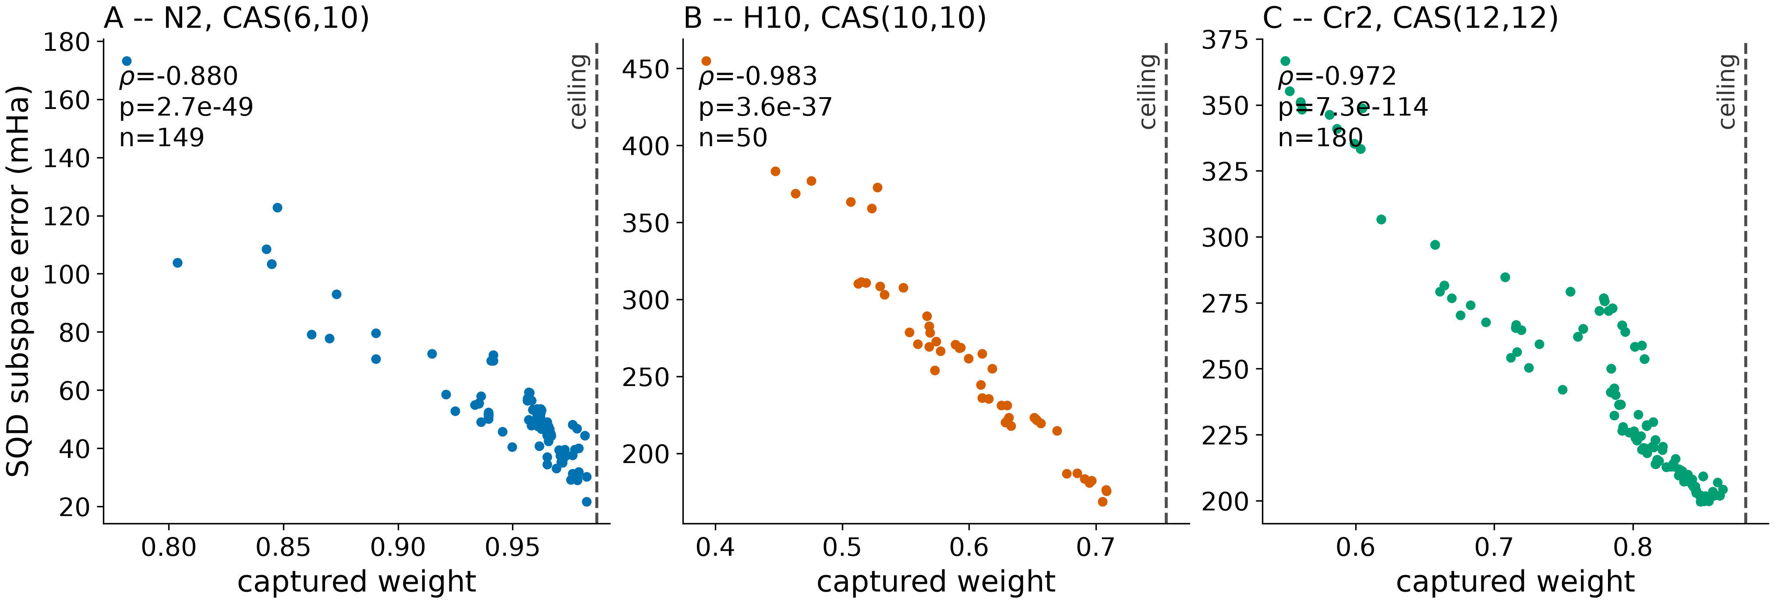
The mechanism: Subspace Capture
How much of the exact wavefunction the sampled subspace contains
Capture = fraction of the exact wavefunction inside the sampled subspace
⍴(capture,error) = -0.88 (N₂), -0.98 (H₁₀), -0.97 (Cr₂)
Holds at 21 chains, 3 systems, 2 bases, 2 correlation regimes
Zero failures, including 12 chains held out from all development
Layout → sampled distribution → capture → SQD error

Slide 12
And it transfers
Three systems, normalised by available headroom
 | H₁₀ | N₂ | Cr₂
Capture ceiling | 0.755 | 0.987 | 0.881
Range/unit headroom (mHa) | 1445 | 2550 | 1677
Raw ranges differ – normalised by headroom, they don’t
Small effect near the ceiling is geometry, not weakness
Cr₂ CAS(12,12): a 3d transition-metal dimer, strongly correlated
On Cr₂ , identity and reverse gave bit-identical results – independent confirmation of the reversal argument

Slide 13
Can we predict a good layout?
Testing cheap scores against the full permutation search

Slide 14
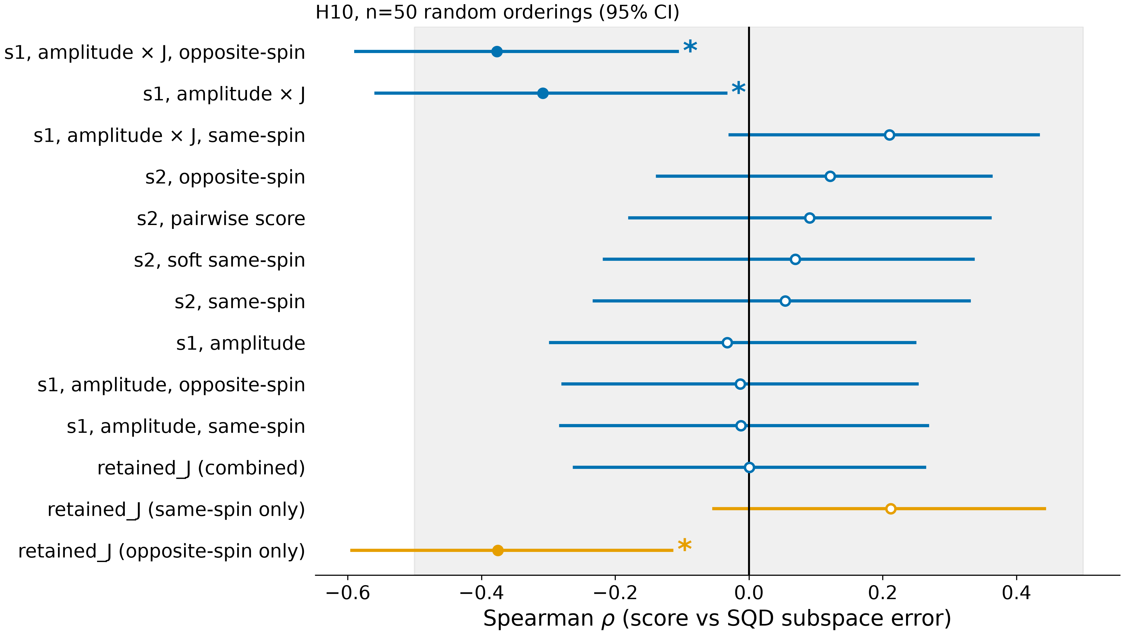
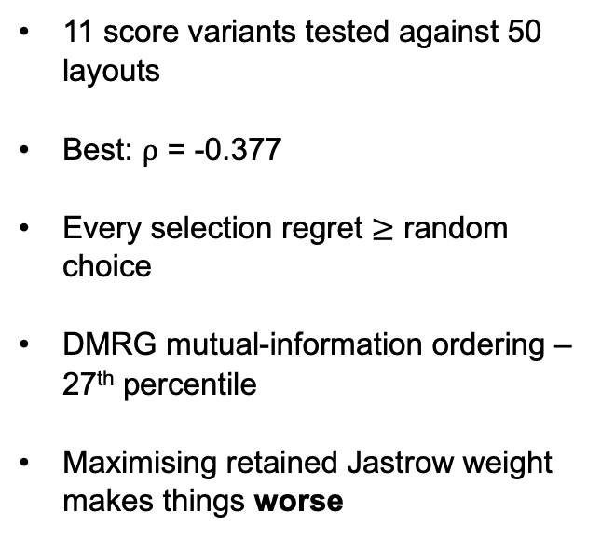
Every cheap predictor fails
Eleven variants, none better than random selection
11 score variants tested against 50 layouts
Best: ⍴ = -0.377
Every selection regret $≥$ random choice
DMRG mutual-information ordering – 27th percentile
Maximising retained Jastrow weight makes things worse

Slide 15
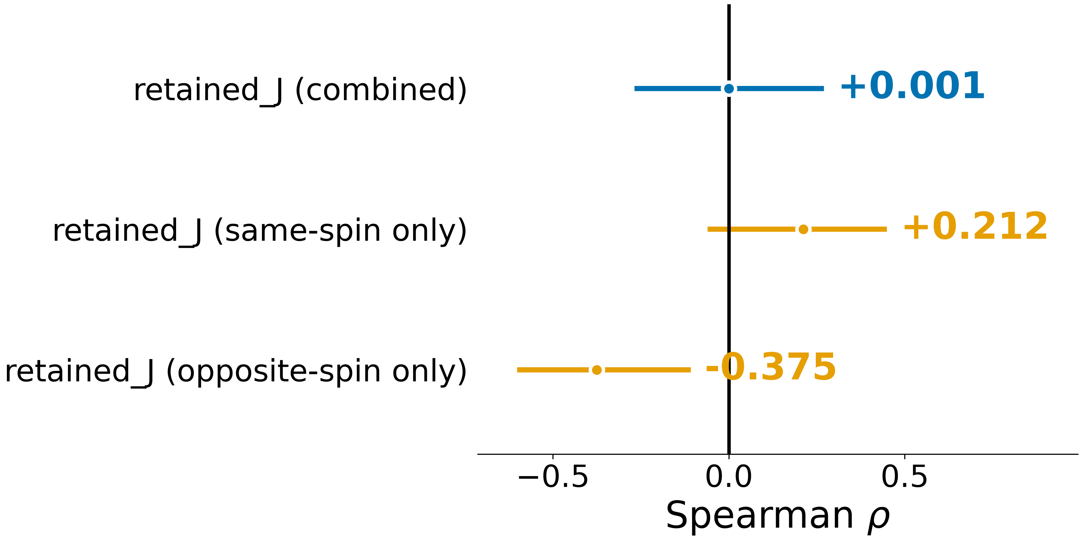
Why did these all fail?
Two spin sectors with opposite signs
Retained J splits by spin sector:
Same-spin: +0.212, Opposite-spin: -0.375
Combined: +0.001
HOW?!
Opposite signs, they cancel out
The only real signal lives in the opposite-spin sector
Separately – capture surrogates fail on resolution, not accuracy
CISD target 97.3% accurate, but differences of 0.5% decide the ranking

Slide 16
The Key Finding
Decomposing the locality mask into two independent design variables

Slide 17
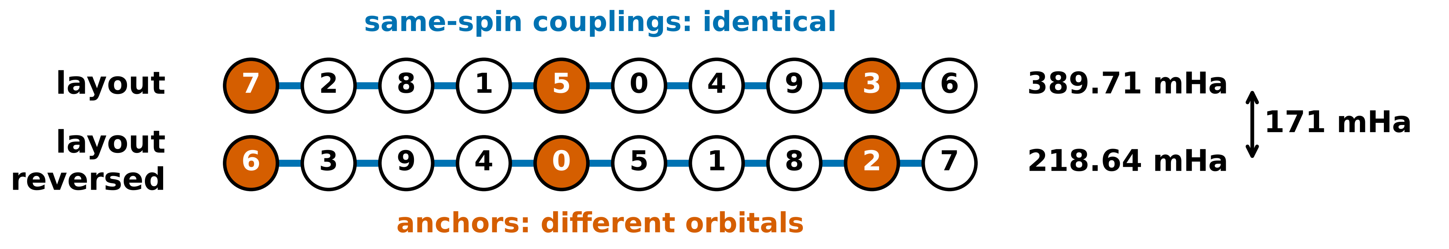
Reversing the layout
Reversal holds same-spin couplings fixed and moves only the anchors
Chain mask keeps neighbours (k, k+1) – reversal maps these to (n-2-k, n-1-k)
Verified for 57/57 layouts
What changes – which orbitals land on opposite-spin anchors
physical: 389.71 mHa
physical_reverse: 218.64 mHa
171 mHa from moving 3 anchors – 60% of the entire random spread

Slide 18
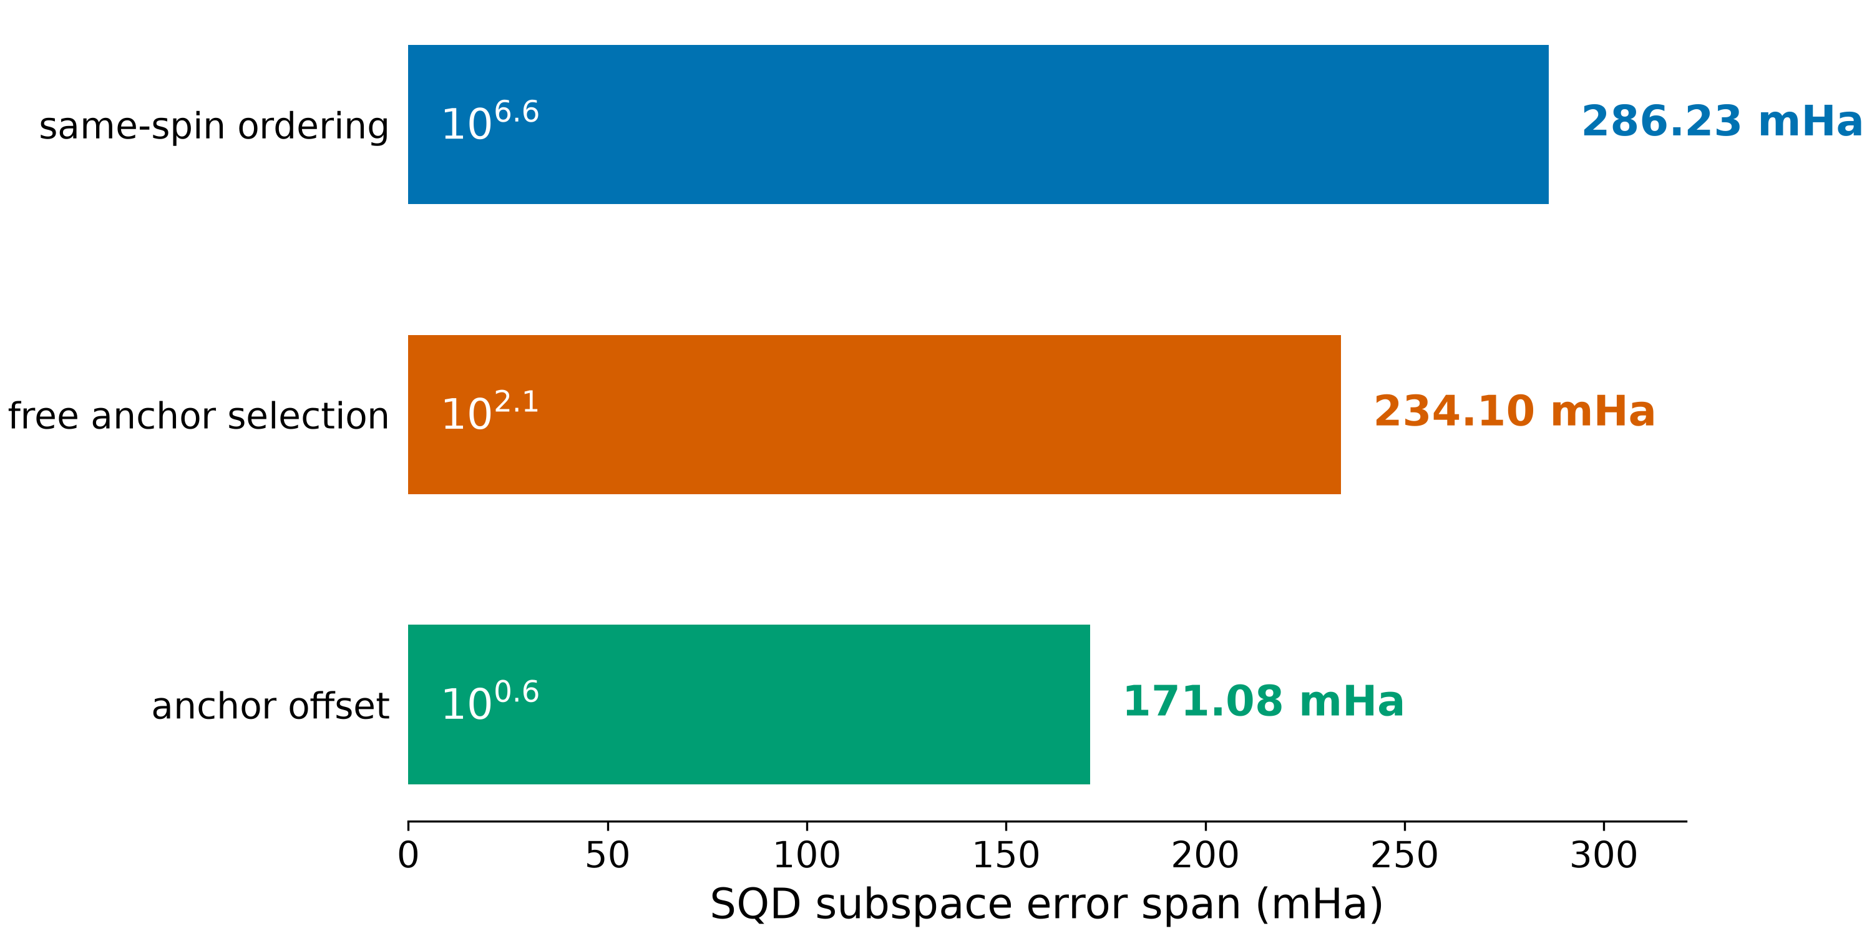
The mask has two levers
Same-spin ordering and opposite-spin anchor placement are separable
Holding the layout fixed and sweeping anchor placement alone spans 171.08 mHa
Against the reversal gap of 171.07 mHa – agrees to 0.01 mHa
The gap is therefore attributable to anchor placement alone!
Same spin ordering: 10! = 3,628,800 choices
Anchor selection: C(10,3) = 120 choices

Slide 19
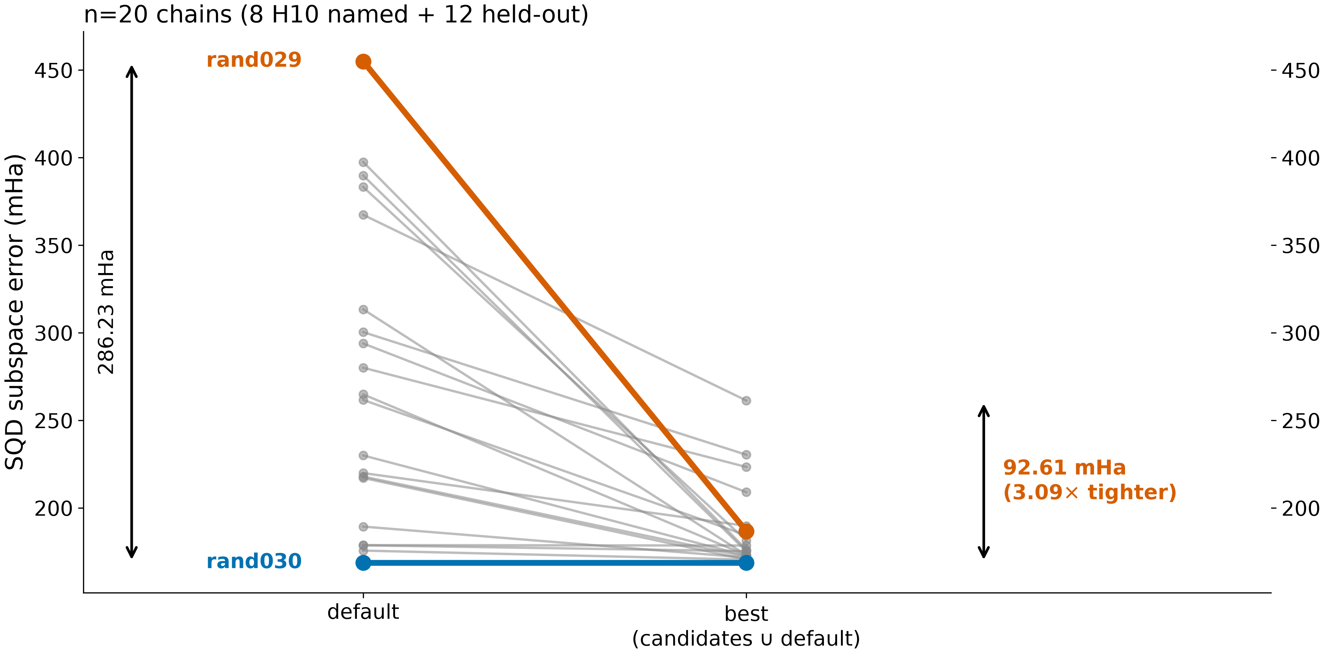
The small lever does most of the work
Anchor selection is crucial
Anchor selection spans 234 mHa from 120 choices
Full permutation search spans 286 mHa from ~ 3.6 million
Optimising anchors compresses the layout spread 3.09x across 20 chains
The worst baseline chain overtakes the best after anchor optimisation!

Slide 20
Can we exploit it?
Building and testing a cheap anchor selection rule

Slide 21
A cheap rule
Opposite-spin Jastrow weight, no wavefunction required
S₀ = sum of |J_{αβ}| over the anchored orbitals. Free to compute
Correct sign at 18 of 18 chains, significant at all 18
Median ρ(capture) = +0.703, worst case +0.361
Predicts the LUCJ variational energy at ρ = −0.85 to −0.97, all three systems
Best anchor triple recovers 75.72 mHa by changing three integers

Slide 22
The deployable objective is a shortlist
Rank, evaluate a handful and take the best
Rank all 120 anchor triples by S₀ – evaluate the top 5 and take the winner
Within 0.2% of the best available candidate
Twelve chains held out from all development, evaluated once
No tail – the 90th percentile equals the median
Best-of-top-5 regret | S₀ | random
Median | 0.002 | 0.181
90th Percentile | 0.002 | 0.621

Slide 23
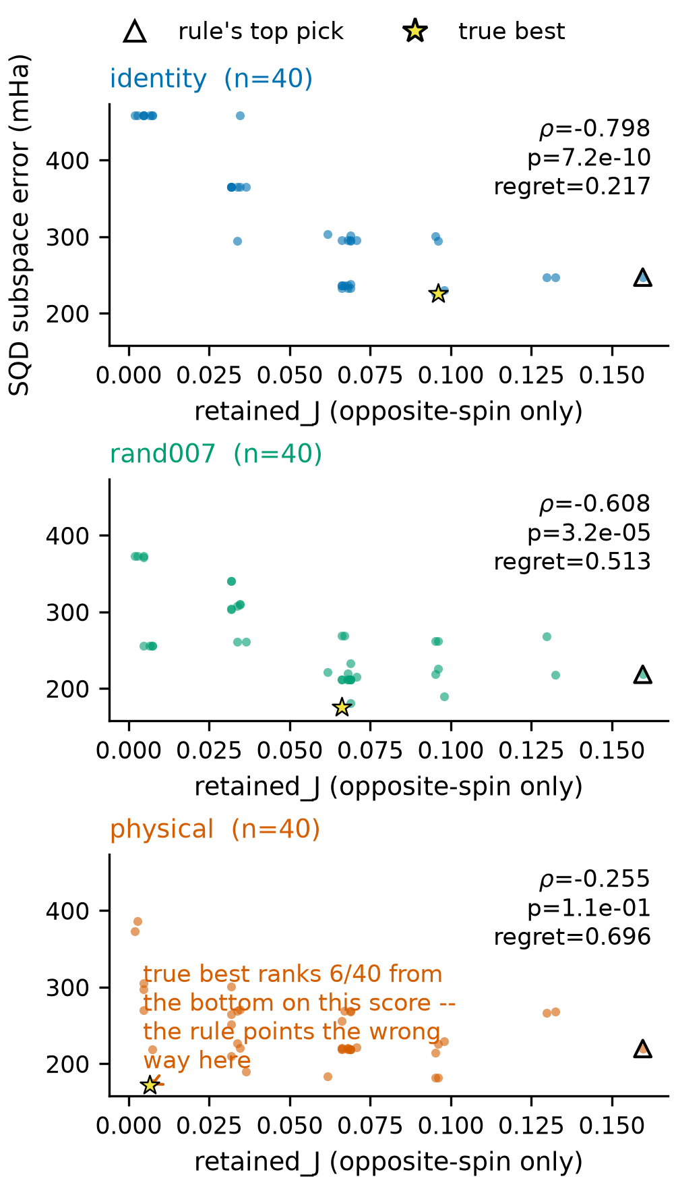
Why we can’t guarantee this rule is general
The score is invariant under the permutation, the optimum is not
S₀ depends only on which orbitals are anchored
It’s exactly invariant under the same-spin permutation
Same 120 values at every chain - but the best triple moves
A fixed ranking chasing a moving target
7 pre-registered chain-aware alternatives: none improves on
Argmax fails at only 1 of 18 chains worse than random
The one failure traces to an exact tie in the score, broken arbitrarily - not to the score itself
Targeting capture directly performed worse (wrong sign at 14-15 of 18 chains)

Slide 24
What this establishes
A structural constraint on any future rule
Anchor selection is worth doing – shortlisting reaches 0.2% of optimal
No opposite-spin only rule can be guaranteed general – proved, not observed
Any successor must use same-spin information
Not a tuning problem - a structural one
The problem is now precisely specified for whoever solves it

Slide 25
Where this goes
Scaling, limitations and the open problem

Slide 26
Circuit resource audit
Does a better layout cost more gates?
Every layout transpiled to CouplingMap.from_heavy_hex, 5 routing seeds each
Better anchors need fewer gates:
ρ(2Q gates, error) = +0.608
Three of four quoted improvements reduce two-qubit account while improving accuracy
Same-spin reordering is the dominant hardware cost:
physical ≈ 26,500 2Q gates and 5,284 SWAPs
identity ≈ 12,800 2Q gates and 650 SWAPs
A second, independent reason to prefer the anchor axis

Slide 27
Scaling
Why the anchor axis is tractable where the permutation search is not
Anchor space: C(36,9) ≈ 9.4×10⁷ vs 36! ≈ 3.7×10⁴¹
At N_{orb} = 20, only 15,504 anchor choices
Combined with shortlisting: rank, evaluate five, take the best
On hardware, sampling is free – the entire cost is enumeration
Fugaku’s value here is throughput, not latency – hundreds of independent short jobs

Slide 28
What we are not claiming
Explicitly stating the limits
Not a rule that finds the optimum at every chain – the opposite is proved
Not a claim that orbital ordering fixes single-reference failure
Not ”fixed quantum resources” – layouts differ in gate count and depth
Anchor axis CV: 5.1% gates, 11.6% depth, same-spin axis: 19.0%,21.7%
Capture is an oracle diagnostic, not a production criterion
Cr₂ is a transfer test of the layout phenomenon, not a chemistry result

Slide 29
Summary
Orbital layout changes SQD error by 8x at fixed budget
Mechanism identified – subspace capture, 21 chains, 3 systems – zero failures.
Mask decomposes into two levers – the smaller one does most of the work
Proof that no opposite-spin-only rule can be general
A deployable shortlist rule, reaching 0.2% of optimal on held-out chains
A previously unexamined design variable, now characterised

Slide 30
Future Work
A chain-aware rule with a generality guarantee, beyond the three families tested
Explain why ansatz quality fails to transmit at some chains
Calidate the shortlist recipe on more systems and shot budgets
Fugaku numerical validation, then anchor enumeration at N_{orb} > 20
[2Fe-2S]-scale active space
Would you be open to this becoming a paper with more research in the future?

Slide 31
Thank You!
Repo: github.com/solovevmax/sqd-orbital-ordering
All data, seeds and hashes public
Research Presentation – RIKEN R-CCS
03/09/2026

